Slide 1



Arrays, Strings and Objects
Arrays, Associative Arrays, Strings, String Operations, Objects
SoftUni Team
Technical Trainers
Software University
http://softuni.bg

Slide 2


Table of Contents
Arrays in PHP
Array Manipulation
Multidimensional Arrays, Associative Arrays
Strings in PHP
String Manipulation
Regular Expressions
Objects in PHP
Creating Classes and Objects
Using Namespaces

Slide 3

Arrays in PHP

Slide 4
What are Arrays?
An array is a ordered sequence of elements
The order of the elements is fixed
Can get the current length (count($array))
In PHP arrays can change their size at runtime (add / delete)
Element of an array
0 1 2 3 4
Element index
Array of 5 elements
… | … | … | … | …

Slide 5

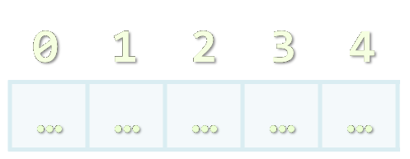

Creating Arrays

Slide 6
Initializing Arrays
There are several ways to initialize an array in PHP:
Using the array(elements) language construct:
Using the array literal []:
Using array_fill($startIndex, $count, $value):
$newArray = array(1, 2, 3); // [1, 2, 3]
$newArray = [7, 1, 5, 8]; // [7, 1, 5, 8]
$newArray = array_fill(0, 3, "Hi"); // ["Hi", "Hi", "Hi"]

Slide 7
Initializing Arrays – Examples
// Creating an empty array
$emptyArray = array();
// Creating an array with 10 elements of value 0.0
$myArray = array_fill(0, 10, 0.0);
// Clearing an array
$myArray = array();
// Adding string elements
$colors = ['green', 'blue', 'red', 'yellow', 'pink', 'purple'];

Slide 8

Declaring PHP Arrays
Live Demo

Slide 9

Accessing Array Elements
Read and Modify Elements by Index

Slide 10
Accessing Array Elements
Array elements are accessed by their key (index)
Using the [] operator
By default, elements are indexed from 0 to count($arr)-1
Values can be accessed / changed by the [ ] operator
0 1 2 3 4
Apple | Pear | Peach | Banana | Melon
$fruits = ['Apple', 'Pear', 'Peach', 'Banana', 'Melon'];
echo $fruits[0]; // Apple
echo $fruits[3]; // Banana

Slide 11
Accessing Array Elements (2)
Changing element values
Iterating through an array
$cars = ['BMW', 'Audi', 'Mercedes', 'Ferrari'];
echo $cars[0]; // BMW
$cars[0] = 'Opel';
print_r($cars); // Opel, Audi, Mercedes, Ferrari
$teams = ['FC Barcelona', 'Milan', 'Manchester United', 'Real Madrid', 'Loko Plovdiv'];
for ($i = 0; $i < count($teams); $i++) {
echo $teams[$i];
}

Slide 12
Append to Array
Arrays in PHP are dynamic (dynamically-resizable)
Their size can be changed at runtime through append / insert / delete
Appending elements at the end:
array_push($array, $element1, $element2, …)
Alternative syntax: $cars[] = 'Lada';
$months = array();
array_push($months, 'January', 'February', 'March');
$months[] = 'April';
// ['January', 'February', 'March', 'April']

Slide 13

Delete from Array
unset($array[$index]) – removes element at given position
Does NOT reorder indexes
Use array_splice() in case proper ordering is important
$array = array(0, 1, 2, 3);
unset($array[2]);
print_r($array); // prints the array
// Array ([0] => 0 [1] => 1 [3] => 3)
Indices remain unchanged

Slide 14
Delete / Insert in Array
array_splice($array, $startIndex, $length) – removes the elements in the given range
array_splice($array, $startIndex, $length, $element) – removes the elements in given range and inserts an element
$names = array('Maria', 'John', 'Richard', 'George');
array_splice($names, 1, 2); // ['Maria', 'George']
$names = array('Jack', 'Melony', 'Helen', 'David');
array_splice($names, 2, 0, 'Don');
// ['Jack', 'Melony', 'Don', 'Helen', 'David']

Slide 15
Displaying Arrays
There are several ways of displaying the entire content of an array:
print_r($names) – prints the array in human-readable form
var_export($names) – prints the array in array form
echo json_encode($names) – prints the array as JSON string
$names = ['Maria', 'John', 'Richard', 'Hailey'];
Array ( [1] => Maria [2] => John [3] => Richard [4] => Hailey )
array ( 1 => 'Maria', 2 => 'John', 3 => 'Richard', 4 => 'Hailey', )
["Maria","John","Richard","Hailey"]

Slide 16


Accessing and Manipulating Arrays
Live Demo

Slide 17
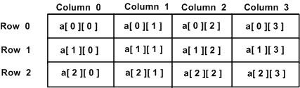
Multidimensional Arrays

Slide 18
Multidimensional Arrays
A multidimensional array is an array containing one or more arrays
Elements are accessed by double indexing: arr[][]
Element is in 'row' 0, 'column' 2,
i.e. $arr[0][2]
One main array whose elements are arrays
0 1 2
0
1
2
4 | 6 | 3
2 | 1 | 2
6 | 7 | 9
Each sub-array contains its own elements

Slide 19
Multidimensional Arrays – Example
Printing a matrix of 5 x 4 numbers:
$rows = 5;
$cols = 4;
$count = 1;
$matrix = [];
for ($r = 0; $r < $rows; $r++) {
$matrix[$r] = [];
for ($c = 0; $c < $cols; $c++) {
$matrix[$r][$c] = $count++;
}
}
print_r($matrix);

Slide 20
Multidimensional Arrays – Example (2)
Printing a matrix as HTML table:
<table border="1">
<?php for ($row = 0; $row < count($matrix); $row++) : ?>
<tr>
<?php for ($col = 0; $col < count($matrix[$row]); $col++) : ?>
<td><?= htmlspecialchars($matrix[$row][$col]) ?></td>
<?php endfor ?>
</tr>
<?php endfor ?>
</table>

Slide 21

Multidimensional Arrays
Live Demo

Slide 22


Associative Arrays

Slide 23
Associative Arrays (Maps, Dictionaries)
Associative arrays are arrays indexed by keys
Not by the numbers 0, 1, 2, 3, …
Hold a set of pairs <key, value>
Traditional array
Associative array
key
value
key
0 1 2 3 4
orange | 2.30
apple | 1.50
tomato | 3.80
value
8 | -3 | 12 | 408 | 33

Slide 24
Associative Arrays in PHP
Initializing an associative array:
Accessing elements by index:
Inserting / deleting elements:
$people = array(
'Gero' => '0888-257124', 'Pencho' => '0888-3188822');
echo $people['Pencho']; // 0888-3188822
$people['Gosho'] = '0237-51713'; // Add 'Gosho'
unset($people['Pencho']); // Remove 'Pencho'
print_r($people); // Array([Gero] => 0888-257124 [Gosho] => 0237-51713)

Slide 25

Iterating Through Associative Arrays
foreach ($array as $key => $value)
Iterates through each of the key-value pairs in the array
$greetings = ['UK' => 'Good morning', 'France' => 'Bonjour', 'Germany' => 'Gutten tag', 'Bulgaria' => 'Ko staa'];
foreach ($greetings as $key => $value) {
echo "In $key people say \"$value\".";
echo "<br>";
}

Slide 26
Counting Letters in Text – Example
$text = "Learning PHP is fun! ";
$letters = [];
$text = strtoupper($text);
for ($i = 0; $i < strlen($text); $i++) {
$char = $text[$i];
if (ord($char) >= ord('A') && ord($char) <= ord('Z')) {
if (isset($letters[$char])) {
$letters[$char]++;
} else {
$letters[$char] = 1;
}
}
}
print_r($letters);
isset($array[$i])
checks if the key exists

Slide 27
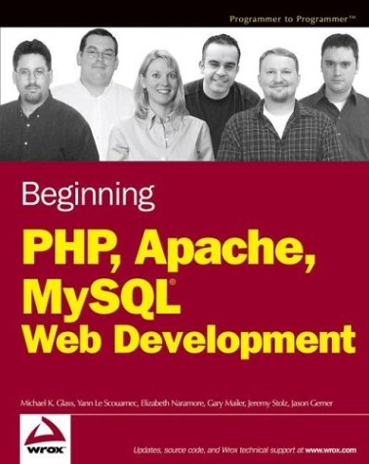

Associative Arrays in PHP
Live Demo

Slide 28

Array Functions in PHP

Slide 29
Sorting Arrays in PHP
sort($array) – sorts an array by its values
$languages = array('PHP', 'HTML', 'Java', 'JavaScript');
sort($languages);
print_r($languages);
// Array ( [0] => HTML [1] => Java [2] => JavaScript [3] => PHP
$nums = array(8, 23, 1, 254, 3);
sort($nums);
print_r($nums);
// Array ( [0] => 1 [1] => 3 [2] => 8 [3] => 23 [4] => 245 ) */

Slide 30
Sorting Arrays in PHP (2)
ksort($array) – sorts an array by its keys
$students = array('Stoyan' => 6.00, 'Penka' => 5.78,
'Maria' => 4.55, 'Stenli' => 5.02);
ksort($students);
print_r($students);
/* Array
(
[Maria] => 4.55
[Penka] => 5.78
[Stenli] => 5.02
[Stoyan] => 6
) */
The keys are sorted lexicographically (as strings)

Slide 31
Sorting by User-Defined Compare Function
Sorting students by their maximal grade using uasort()
$arr = [
"Gosho" => 3.55, "Mimi" => 6.00,
"Pesho" => [3.00, 3.50, 3.40],
"Zazi" => [5.00, 5.26]
];
uasort($arr, function ($a, $b) {
$first = is_array($a) ? max($a) : $a;
$second = is_array($b) ? max($b) : $b;
return $first - $second;
});
echo json_encode($arr);

Slide 32
Merging Arrays in PHP
array_merge($array1, $array2, …)
Joins (appends) the elements of one more arrays
Returns the merged array
$lightColors = array('yellow', 'red', 'pink', 'magenta');
$darkColors = array('black', 'brown', 'purple', 'blue');
$allColors = array_merge($lightColors, $darkColors);
print_r($allColors);
// Array ( [0] => yellow [1] => red [2] => pink [3] => magenta [4] => black [5] => brown [6] => purple [7] => blue )

Slide 33
Joining Arrays in PHP
implode($delimiter, $array)
Joins array elements with a given separator
Returns the result as string
$ingredientsArray =
array('salt', 'peppers', 'tomatoes', 'walnuts', 'love');
$ingredientsString = implode(' + ', $ingredientsArray);
echo $ingredientsString . ' = gross cake';
// salt + peppers + tomatoes + walnuts + love = gross cake

Slide 34
Other Array Functions
extract($array) – extracts the keys of the array into variables
rsort($array) – sorts the array by values in reversed order
array_fill($startIndex, $length, $value) – fills an array with values in the specified range and returns it
$people = ['John' => 5000, 'Pesho' => 300];
extract($people);
echo $John; // 5000
$array = [];
$array = array_fill(0, 5, '4'); // [4, 4, 4, 4, 4]

Slide 35

Array Functions in PHP
Live Demo

Slide 36


Strings in PHP

Slide 37
Strings in PHP
A string is a sequence of characters
Can be assigned a literal constant or a variable
Text can be enclosed in single (' ') or double quotes (" ")
Strings in PHP are mutable
Therefore concatenation is a relatively fast operation
<?php
$person = '<span class="person">Mr. Svetlin Nakov</span>';
$company = "<span class='company'>Software University</span>";
echo $person . ' works @ ' . $company;
?>

Slide 38
String Syntax
Single quotes are acceptable in double quoted strings
Double quotes are acceptable in single quoted strings
Variables in double quotes are replaced with their value
echo "<p>I'm a Software Developer</p>";
echo '<span>At "Software University"</span>';
$name = 'Nakov';
$age = 25;
$text = "I'm $name and I'm $age years old.";
echo $text; // I'm Nakov and I'm 25 years old.

Slide 39
Interpolating Variables in Strings
Simple string interpolation syntax
Directly calling variables in double quotation marks (e.g. "$str")
Complex string interpolation syntax
Calling variables inside curly parentheses (e.g. "{$str}")
Useful when separating variable from text after
$popularName = "Pesho";
echo "This is $popularName."; // This is Pesho.
echo "These are {$popularNames}s."; // These are Peshos.

Slide 40
Heredoc Syntax for PHP Strings
Heredoc syntax <<<EOD .. EOD;
$name = "Didko";
$str = <<<EOD
My name is $name and I am
very, very happy.
EOD;
echo $str;
/*
My name is Didko and I am
very, very happy.
*/

Slide 41
String Concatenation
In PHP, there are two operators for combining strings:
Concatenation operator .
Concatenation assignment operator .=
The escape character is the backslash \
<?php
$homeTown = "Madan";
$currentTown = "Sofia";
$homeTownDescription = "My home town is " . $homeTown . "\n";
$homeTownDescription .= "But now I am in " . $currentTown;
echo $homeTownDescription;

Slide 42
Unicode Strings in PHP
By default PHP uses the legacy 8-bit character encoding
Like ASCII, ISO-8859-1, windows-1251, KOI8-R, …
Limited to 256 different characters
You may use Unicode strings as well, but:
Most PHP string functions will work incorrectly
You should use multi-byte string functions
E.g. mb_substr() instead of substr()

Slide 43
Unicode Strings in PHP – Example
Printing Unicode text and processing it letter by letter:
mb_internal_encoding("utf-8");
header('Content-Type: text/html; charset=utf-8');
$str = 'Hello, 你好，你怎么样,السلام عليكم , здрасти';
echo "<p>str = \"$str\"</p>";
for ($i = 0; $i < mb_strlen($str); $i++) {
// $letter = $str[$i]; // this is incorrect!
$letter = mb_substr($str, $i, 1);
echo "str[$i] = $letter<br />\n";
}

Slide 44

Strings in PHP
Live Demo

Slide 45

Manipulating Strings

Slide 46
Accessing Characters and Substrings
strpos($input, $find) – a case-sensitive search
Returns the index of the first occurrence of string in another string
strstr($input, $find, [boolean]) – finds the first occurrence of a string and returns everything before or after
$soliloquy = "To be or not be that is the question.";
echo strpos($soliloquy, "that"); // 16
var_dump(strpos($soliloquy, "nothing")); // bool(false)
echo strstr("This is madness!\n", "is ") ; // is madness!
echo strstr("This is madness!", " is", true); // This

Slide 47
Accessing Characters and Substrings (2)
substr($str, $position, $count) – extracts $count characters from the start or end of a string
$str[$i] – gets a character by index
$str = "abcdef";
echo substr($str, 1) ."\n"; // bcdef
echo substr($str, -2) ."\n"; // ef
echo substr($str, 0, 3) ."\n"; // abc
echo substr($str, -3, 1); // d
php $str = "Apples";
echo $str[2]; // p

Slide 48
Counting Strings
strlen($str) – returns the length of the string
str_word_count($str) – returns the number of words in a text
count_chars($str) – returns an associative array holding the value of all ASCII symbols as keys and their count as values
echo strlen("Software University"); // 19
$countries = "Bulgaria, Brazil, Italy, USA, Germany";
echo str_word_count($countries); // 5
$hi = "Helloooooo";
echo count_chars($hi)[111]; // 6 (o = 111)

Slide 49
Accessing Character ASCII Values
ord($str[$i]) – returns the ASCII value of the character
chr($value) – returns the character by ASCII value
$text = "Call me Banana-man!";
echo ord($text[8]); // 66
$text = "SoftUni";
for ($i = 0; $i < strlen($text); $i++) {
$ascii = ord($text[$i]);
$text[$i] = chr($ascii + 5);
}
echo $text; // XtkyZsn

Slide 50
String Replacing
str_replace($target, $replace, $str) – replaces all occurrences of the target string with the replacement string
str_ireplace($target, $replace, $str) - case-insensitive replacing
$email = "bignakov@example.com";
$newEmail = str_replace("bignakov", "juniornakov", $email);
echo $newEmail; // juniornakov@example.com
$text = "HaHAhaHAHhaha";
$iReplace = str_ireplace("A", "o", $text);
echo $iReplace; // HoHohoHoHhoho

Slide 51
Splitting Strings
str_split($str, $length) – splits each character into a string and returns an array
$length specifies the length of the pieces
explode($delimiter, $string) – splits a string by a string
$text = "Hello how are you?";
$arrSplit = str_split($text, 5);
var_export($arrSplit);
// array ( 0 => 'Hello', 1 => ' how ', 2 => 'are y', 3 => 'ou?', )
echo var_export(explode(" ", "Hello how are you?"));
// array ( 0 => 'Hello', 1 => 'how', 2 => 'are', 3 => 'you?', )

Slide 52
Case Changing
strtolower() – makes a string lowercase
strtoupper() – makes a string uppercase
$str[$i] – access / change any character by index
php $lan = "JavaScript";
echo strtolower($lan); // javascript
php $name = "parcal";
echo strtoupper($name); // PARCAL
$str = "Hello";
$str[1] = 'a';
echo $str; // Hallo

Slide 53
Other String Functions
strcasecmp($string1, $string2)
Performs a case-insensitive string comparison
strcmp() – performs a case-sensitive comparison
trim($text) – strips whitespace (or other characters) from the beginning and end of a string
echo !strcmp("hELLo", "hello") ? "true" : "false"; // false
$boo = " \"it's wide in here\" ";
echo trim($boo); // "it's wide in here"

Slide 54



Manipulating Strings
Live Demo

Slide 55

Regular Expressions in PHP
Splitting, Replacing, Matching

Slide 56
Regular Expressions
Regular expressions match text by pattern, e.g.:
[0-9]+ matches a non-empty sequence of digits
[a-zA-Z]* matches a sequence of letters (including empty)
[A-Z][a-z]+ [A-Z][a-z]+ → first name + space + last name
\s+ matches any whitespace; \S+ matches non-whitespace
\d+ matches digits; \D+ matches non-digits
\w+ matches letters (Unicode); \W+ matches non-letters
\+\d{1,3}([ -]*[0-9]+)+ matches international phone
Test your regular expressions at http://regexr.com

Slide 57
Splitting with Regex
preg_split($pattern, $str, $limit, $flags)
Splits a string by a regex pattern
$limit specifies the number of returned substrings (-1 == no limit)
$flags specify additional operations (e.g. PREG_SPLIT_NO_EMPTY)
$text = "I love HTML, CSS, PHP and MySQL.";
$tokens = preg_split("/\W+/", $text, -1, PREG_SPLIT_NO_EMPTY);
echo json_encode($tokens);
// ["I","love","HTML","CSS","PHP","and","MySQL"]
Splits by 1 or more non-word characters

Slide 58
Matching with Regex with Groups
preg_match_all($pattern, $text, $matches, $flags)
$text = "S. Rogers | New York |s_rogers@gmail.com \n" .
" Maria Johnson |Seattle | maria.j@gmail.com \n" .
"// This line is not in the correct format\n" .
"Diana|V.Tarnovo|didi@abv.bg".
$pattern = '/(.+?)\|(.+?)\|(.+)/';
preg_match_all($pattern, $text, $results, PREG_SET_ORDER);
foreach ($results as $match) {
$name = trim($match[1]); // first group
$town = trim($match[2]); // second group
$email = trim($match[3]); // third group
echo "name=$name town=$town email=$email\n";
}

Slide 59
Replacing with Regex
preg_replace($pattern, $replace, $str) – performs a regular expression search and replace by a pattern
() – defines the groups that should be returned as result
\1 – denotes the first match group, \2 – the second, etc.
$string = 'August 20, 2014';
$pattern = '/(\w+) (\d+), (\d+)/';
$replacement = '\2-\1-\3';
echo preg_replace($pattern, $replacement, $string);
// 20-August-2014

Slide 60
Replacing with Regex with Callback
preg_replace_callback($pattern, $callback, $text) – performs a regex search and replace with a callback function
$text = "April fools day is on 01/04/2013.\n" .
"Last Christmas was on 24/12/2013.\n";
function nextYear($matches) {
return $matches[1] . ($matches[2] + 1);
}
echo preg_replace_callback(
'/(\d{2}\/\d{2}\/)(\d{4})/', "nextYear", $text);
/* April fools day is on 01/04/2014.
Last Christmas was on 24/12/2014. */

Slide 61
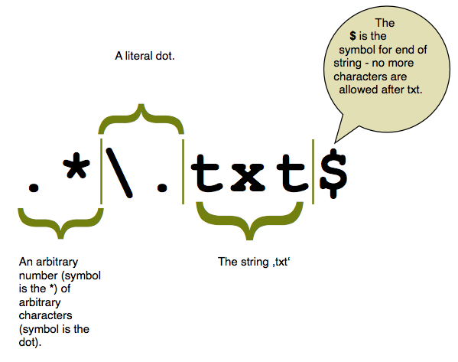
Regular Expressions in PHP
Live Demo

Slide 62
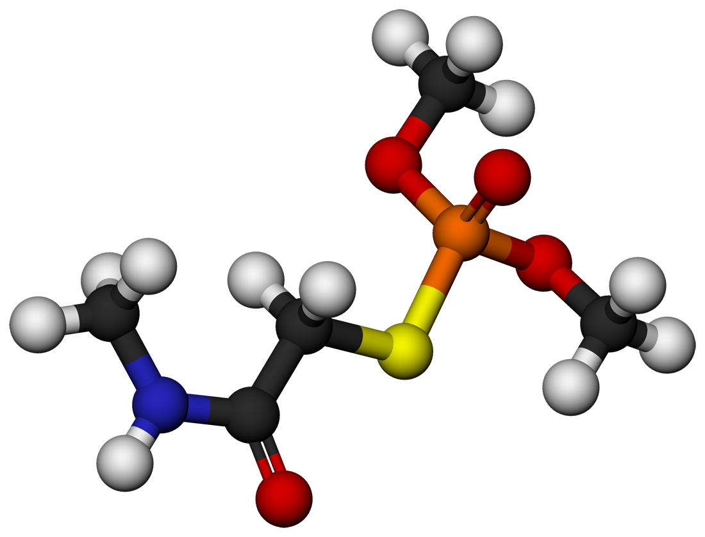

Classes and Objects in PHP

Slide 63
Classes and Objects in PHP
PHP supports Object-Oriented Programming (OOP)
Supports custom classes, objects, interfaces , namespaces, exceptions
Like other OOP languages (C#, Java, C++)
class Rock {
public $height = 12;
function fall() {
$this->height--;
}
}
$myRock = new Rock();
$myRock->fall();
echo $myRock->height; // 11

Slide 64
Classes and Objects – Example
class Student {
public $name;
public $age;
public function __construct($name = null, $age = null) {
$this->name = $name;
$this->age = $age;
}
}
$peter = new Student("Peter", 21);
echo $peter->name;
$peter->age = 25;
print_r($peter); // Student Object ( [name] => Peter [age] => 25 )
$maria = new Student('Maria');
print_r($maria); // Student Object ( [name] => Peter [age] => )

Slide 65

Anonymous Objects in PHP
The stdClass is an empty generic PHP class for initializing objects of anonymous type (e.g. $obj = new stdClass;)
It is NOT the base class for objects in PHP
Objects can contain their own properties
e.g. $obj->prop = value;
$anonCat = new stdClass;
$anonCat->weight = 14;
echo 'My cat weighs ' . $anonCat->weight . ' kg.';
// My cat weighs 14 kg.

Slide 66
Anonymous Objects – Example
$person = new stdClass;
$person->name = 'Chinese';
$person->age = 43;
$person->weapons = ['AK-47', 'M-16', '9mm-Glock', 'Knife'];
echo json_encode($person);
// {"name":"Chinese","age":43,"weapons":["AK-47","M-16","9mm-Glock","Knife"]}
$obj = (object)['name' => 'Peter', 'age' => 25];
$obj->twitter = '@peter';
echo json_encode($obj);
// {"name":"Peter","age":25,"twitter":"@peter"}

Slide 67


Classes and Objects in PHP
Live Demo

Slide 68
Namespaces
Namespaces are used to group code (classes, interfaces, functions, etc.) around a particular functionality
Better structure for your code, especially in big projects
Classes, functions, etc. in a namespace are automatically prefixed with the name of the namespace (e.g. MVC\Models\Lib1\Class1)
Using a namespace in PHP:
use CalculationsManager;
$interest = CalculationsManager\getCurrentInterest();
$mysqli = new \mysqli("localhost", "root", "", "world");

Slide 69
Namespaces – Example
<?php
namespace SoftUni {
function getTopStudent() {
return "Pesho";
}
}
namespace NASA {
use SoftUni;
$topSoftUniStudent = SoftUni\getTopStudent();
echo $topSoftUniStudent; // Pesho
}
?>
Declares the use of given namespace
Uses a function from the SoftUni namespace

Slide 70

Summary
PHP supports arrays
Classical, associative, multidimensional
Many built-in array functions, e.g. sort()
Strings in PHP are non-Unicode
Many built-in functions: strlen() and substr()
Regular expressions are powerful in string processing
preg_split(), preg_replace(), preg_match_all()
PHP supports classes, objects and anonymous objects
PHP supports namespaces to split program logic into modules

Slide 71







PHP Arrays, Strings and Objects
https://softuni.bg/courses/php-basics/

Slide 72
License
This course (slides, examples, demos, videos, homework, etc.) is licensed under the "Creative Commons Attribution-NonCommercial-ShareAlike 4.0 International" license
Attribution: this work may contain portions from
"PHP Manual" by The PHP Group under CC-BY license
"PHP and MySQL Web Development" course by Telerik Academy under CC-BY-NC-SA license

Slide 73





Free Trainings @ Software University
Software University Foundation – softuni.org
Software University – High-Quality Education, Profession and Job for Software Developers
softuni.bg
Software University @ Facebook
facebook.com/SoftwareUniversity
Software University @ YouTube
youtube.com/SoftwareUniversity
Software University Forums – forum.softuni.bg

